Slide 1
Journey of a Seed
www.Cigarandrum.com

Slide 2
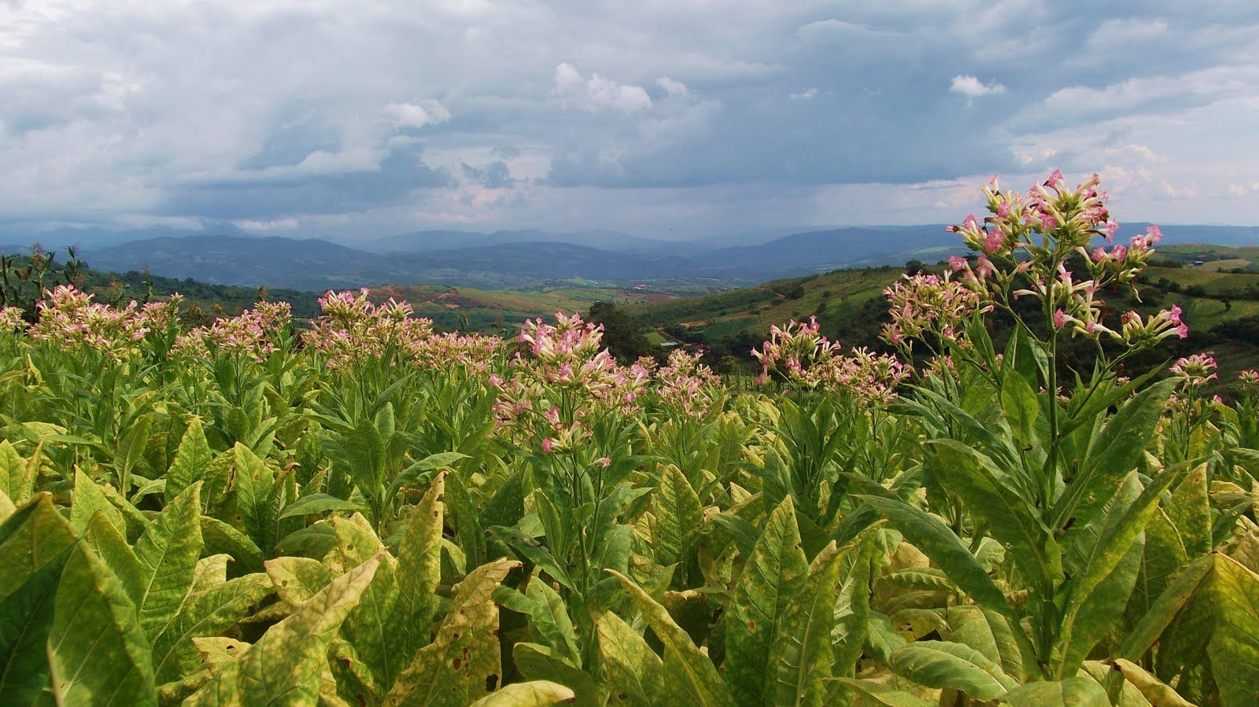
SEEDS & PLANTS
Tobacco plants grow to 6 feet in 8 – 10 months
They are harvested beginning late February
Leaves are picked (primed) in pairs from the bottom to the top (6-7 pairs per tree)
Leaves are sorted, bundled and hung from poles to dry
After of drying the leaves are stacked in bundles to ferment
Notes:
Two most famous seed varietals in the history of cigars: Corojo and Criollo. Their descendants are in most premium cigars made today. While many hybrids have been created over the years [in and outside of Cuba], these two legendary seed strains make excellent specimens for serious study.

Slide 3
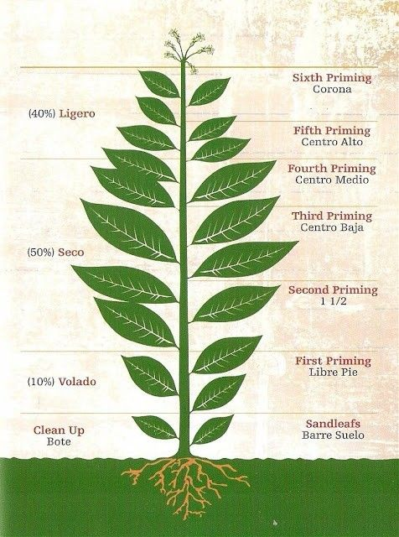
Leaves
Ligero leaves are at the top of the tobacco plant and are considered the strongest and most flavorful due to their direct exposure to sunlight.
Viso leaves generally comprise the filler tobacco for cigars. The flavors and strength of the leaves become more subtle the lower you go in the primings.
Seco leaves generally comprise the filler tobacco for cigars. The flavors and strength of the leaves become more subtle the lower you go in the primings.
Capote leaves are used for the binder leaf of a cigar. Capote leaves are found just above Volado leaves on a tobacco plant.
Viso
Capote
Notes:
Two most famous seed varietals in the history of cigars: Corojo and Criollo. Their descendants are in most premium cigars made today. While many hybrids have been created over the years [in and outside of Cuba], these two legendary seed strains make excellent specimens for serious study.

Slide 4
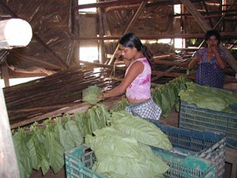
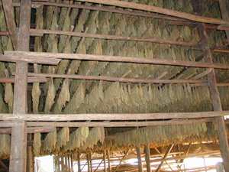
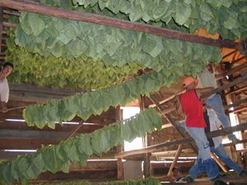
Air Curing

Slide 5
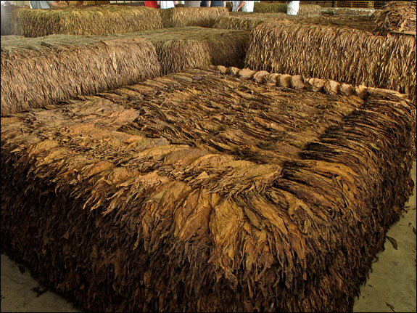
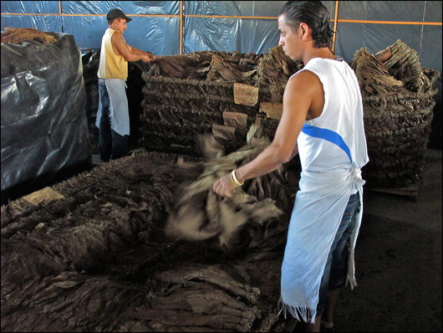
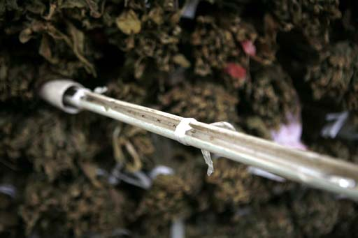
Fermentation

Slide 6
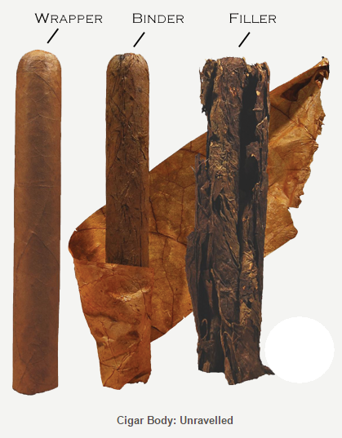
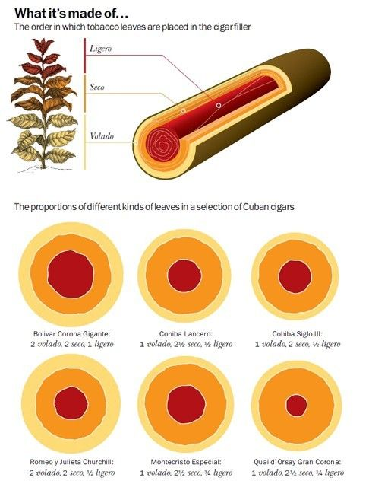
Cigar Makeup

Slide 7
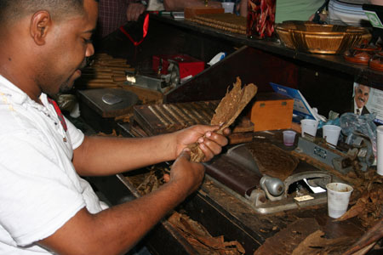
Cigar Makeup

Slide 8
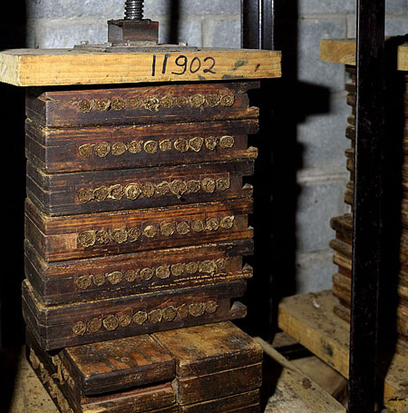
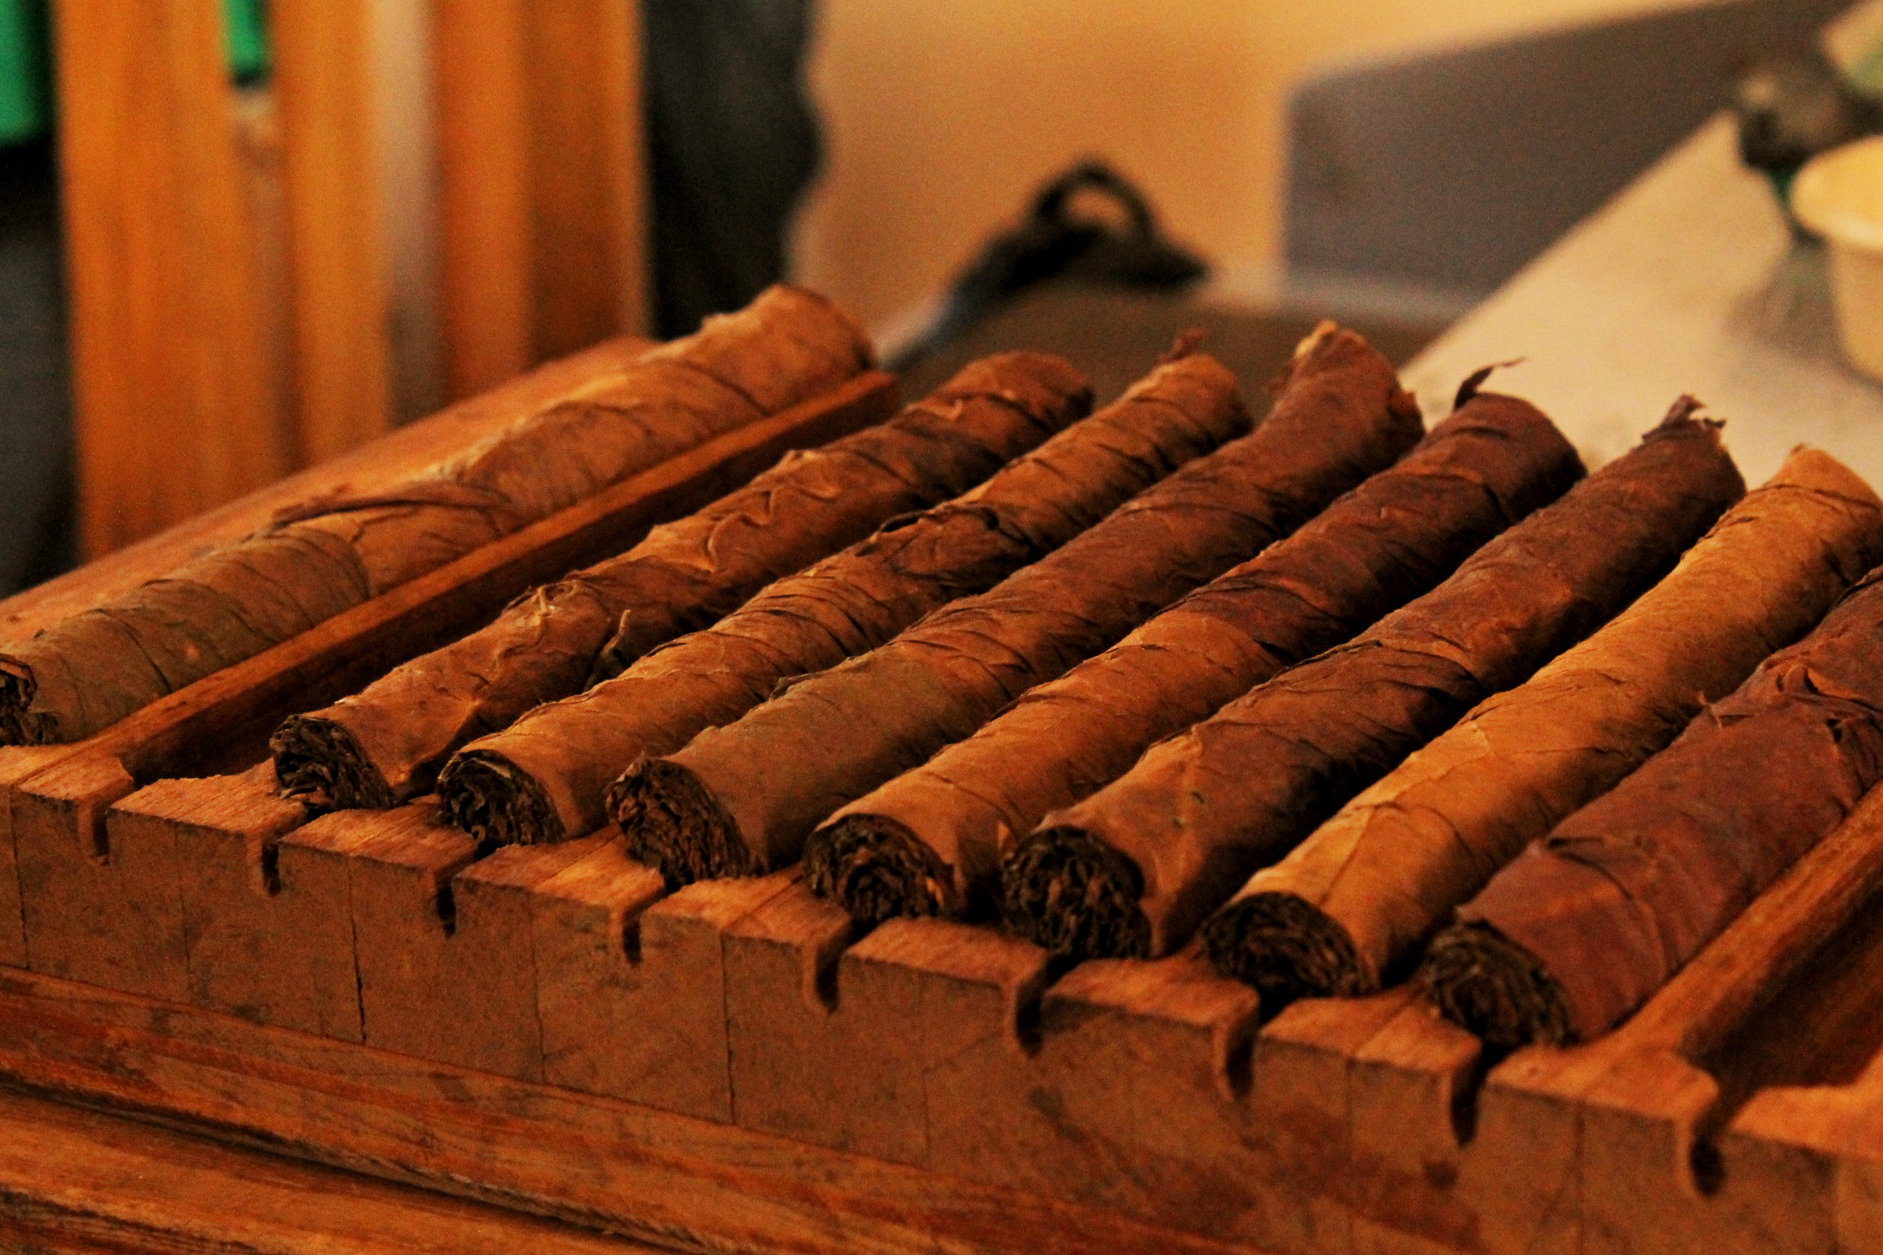
Cigar Makeup

Slide 9
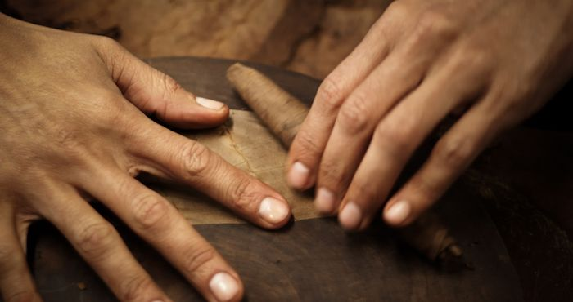
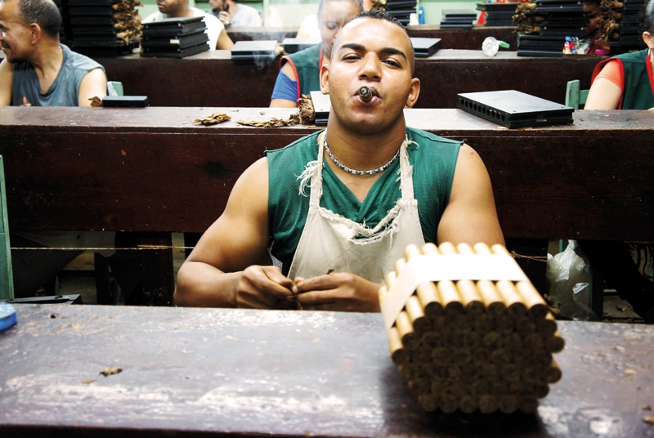
Cigar Makeup

Slide 10
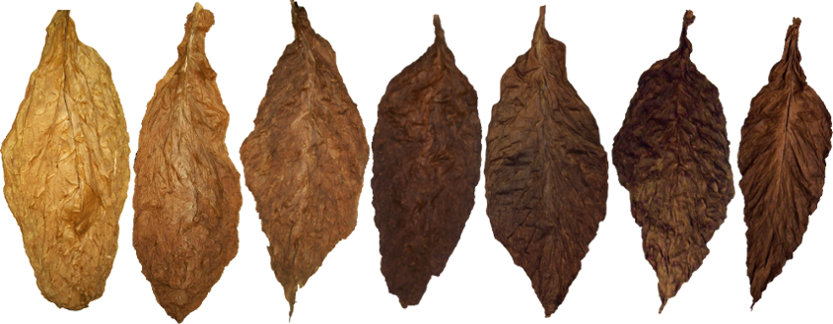
Wrapper Leave Color
Double Claro
Claro
Naural
Colorado Claro
Colorado
Colorado Maduro
Maduro
Oscuro
Notes:
Two most famous seed varietals in the history of cigars: Corojo and Criollo. Their descendants are in most premium cigars made today. While many hybrids have been created over the years [in and outside of Cuba], these two legendary seed strains make excellent specimens for serious study.

Slide 11
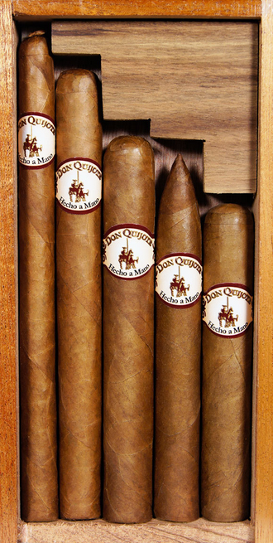
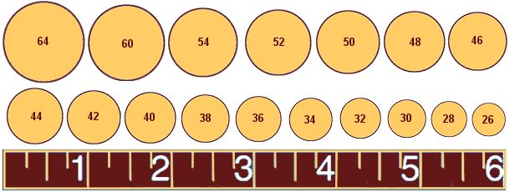
Cigar Sizes & Shape
Robusto 5 x 50
Torpedo 5.75 x 50
Toro 6 x 52
Churchill 7 x 50
Lancero 7.5 x 30

Slide 12
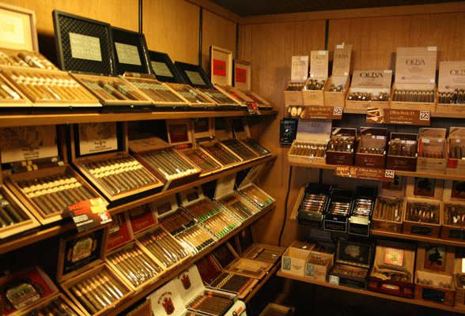
Etiquette
CHOOSING A CIGAR
DO’s
Ask your Tobacconist for suggestions
Ask for strong, medium or mild cigar
Ask for spicy cigars (if that’s your thing)
Take your time and try different cigars
DON’Ts
Squeeze the cigar in the humidor
Pick up the cigar and rub it on your nose to smell it
Don’t get stuck on brand names, there lots of good cigars out there

Slide 13
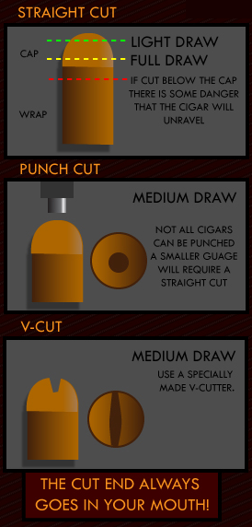
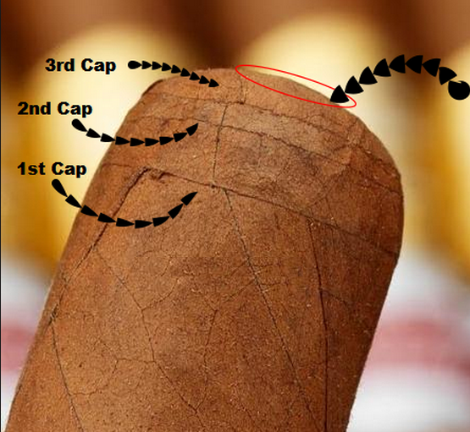
Etiquette
Cutting Your Cigar
DO’s
Ask your tobacconist to cut it
Ask you friend to cut it
DON’Ts
Cut below the 2nd Cap
Bite the tip off
Chew on your cigar

Slide 14
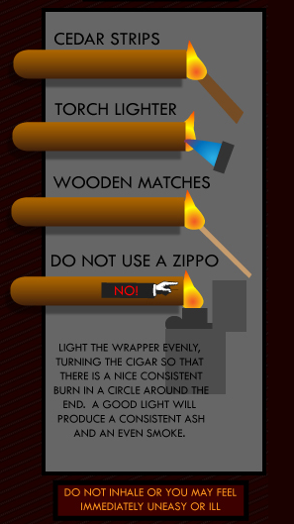
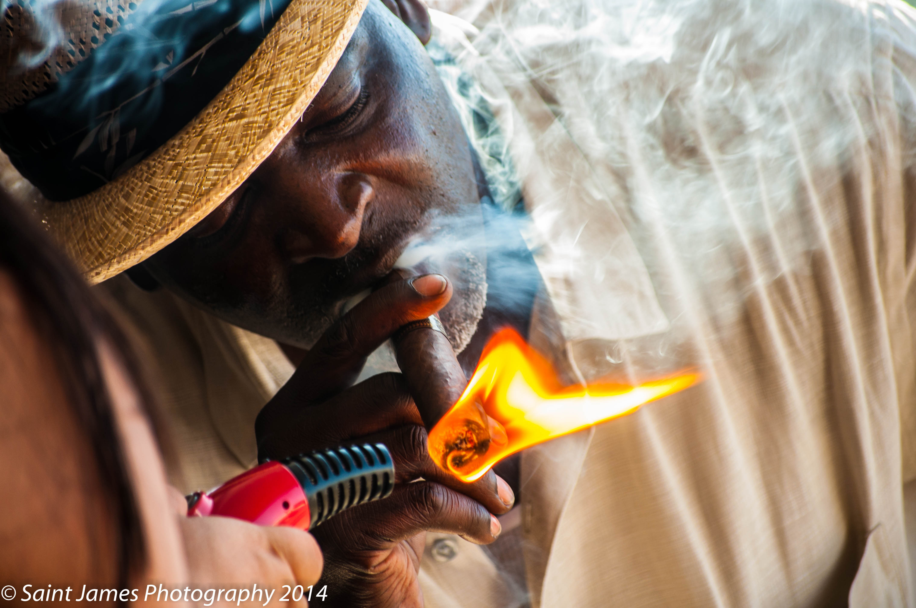
Etiquette
Lighting Your Cigar
DO’s
Ask your tobacconist if they mind
Rotate to evenly light the end
Hold the flame away from the cigar, and draw slowly
DON’Ts
INHALE

Slide 15
Etiquette
Smoking: Cigars are meant to be savored and appreciated for the taste, the feel, and the aroma. Don't rush it.
Ask: Some people around you might not share your love for cigars, which is why it’s recommended that you ask a simple “May I?” to anyone nearby before torching up that cigar.
Relighting: If you need to relight your cigar, first clear off all the ash by gently rubbing or tapping your cigar

Slide 16
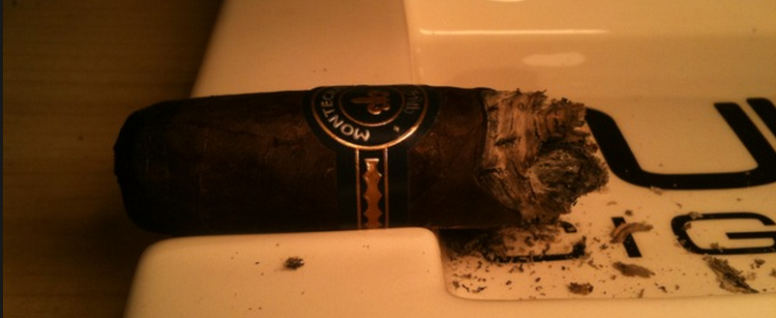
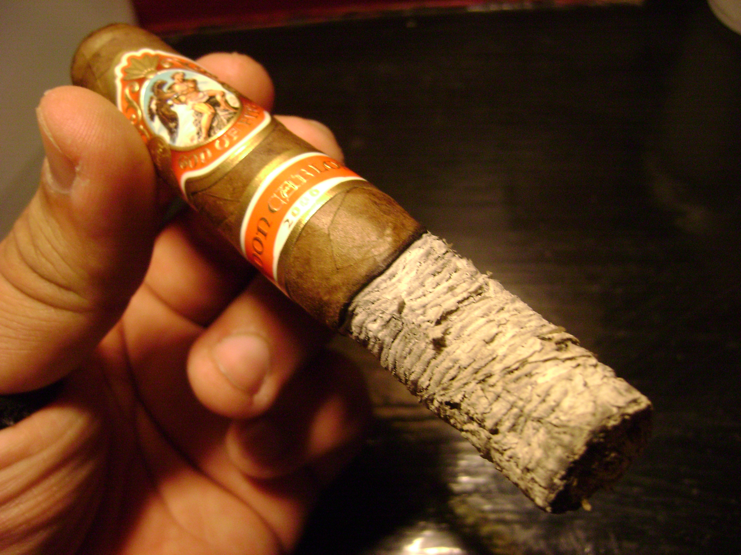
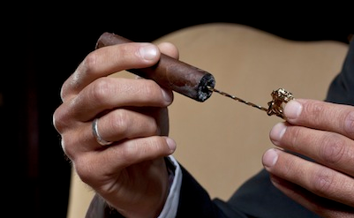
Etiquette
Ash: Most say to let the ash linger on the cigar until it falls of its own accord, and not to flick it into your ashtray (it’s not a cigarette).
Extinguishing: Let your cigar rest in an ashtray and it will extinguish itself. Do not mash it out, as you would with a cigarette.
Tight Draws: Try using a poker if your not successful you tobacconist will replace your cigar.
Thank you!

Slide 17
Thank you!
www.Cigarandrum.com

